Slide 1
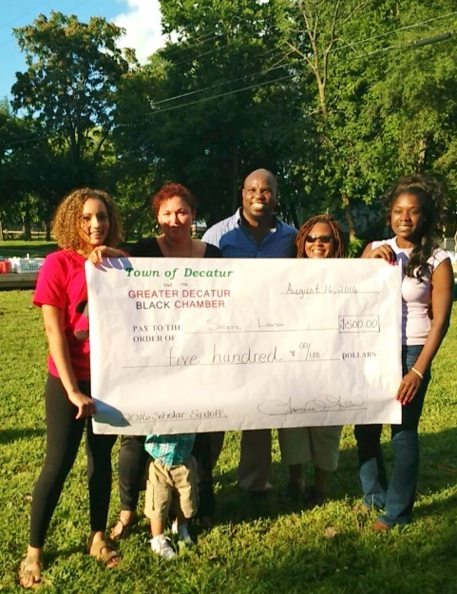
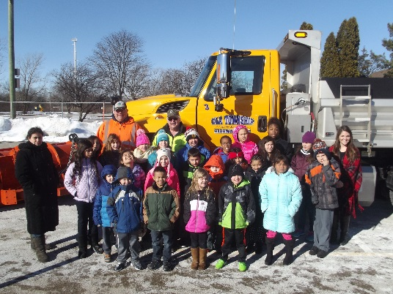
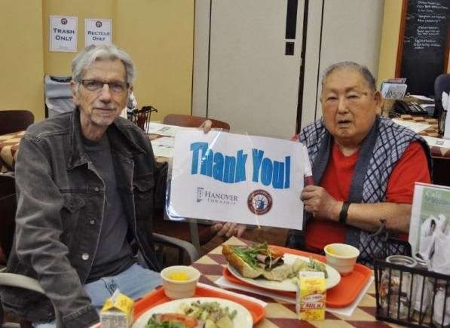
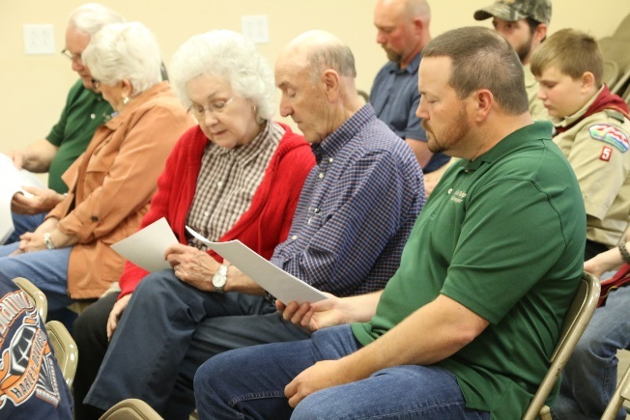
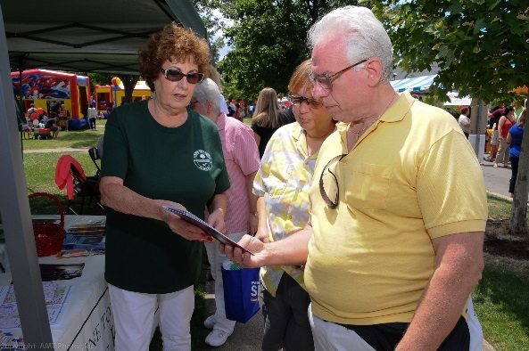
TOI Annual Education Conference
November 13-15, 2016
Springfield, Illinois

Slide 2
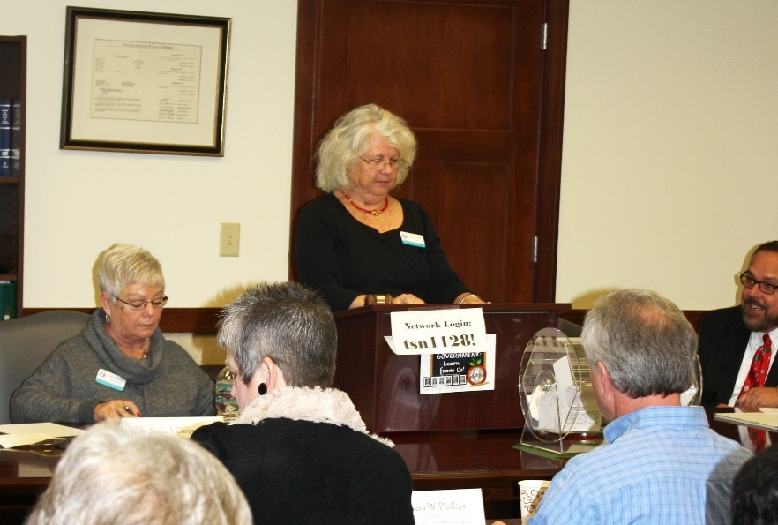
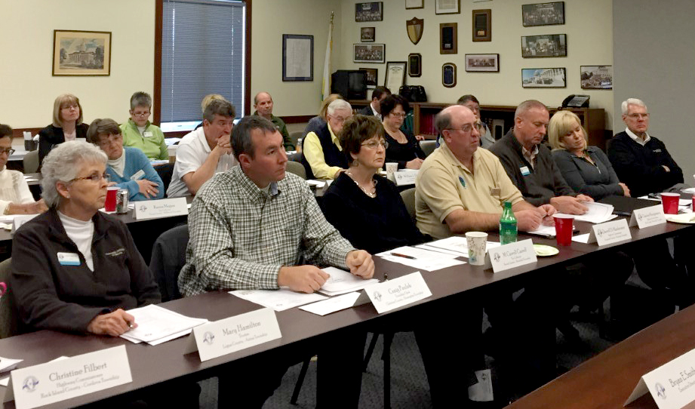
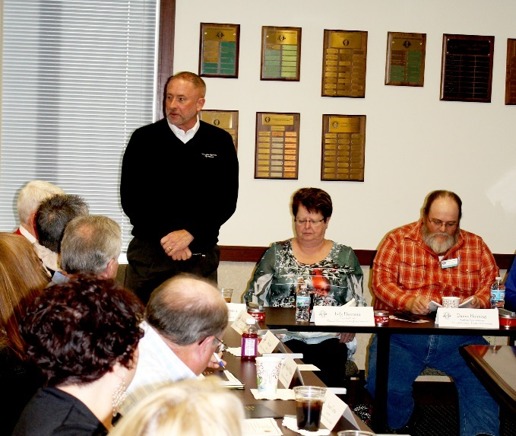
2016 Board of Directors

Slide 3
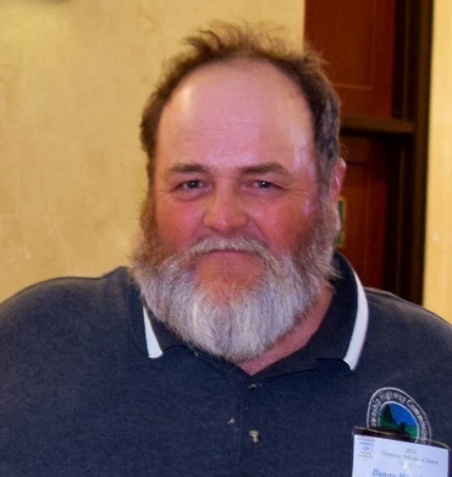
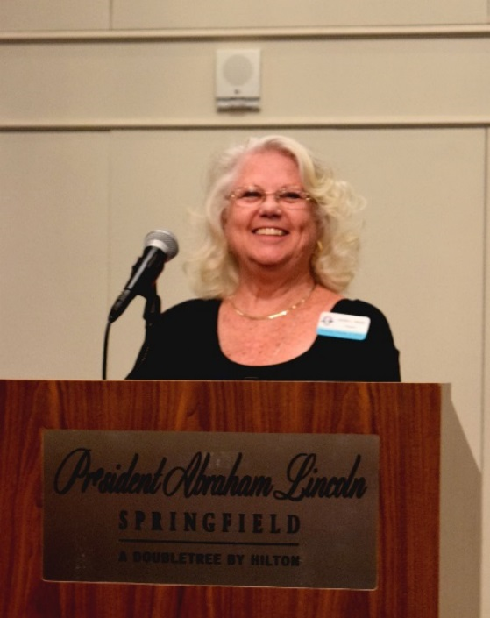
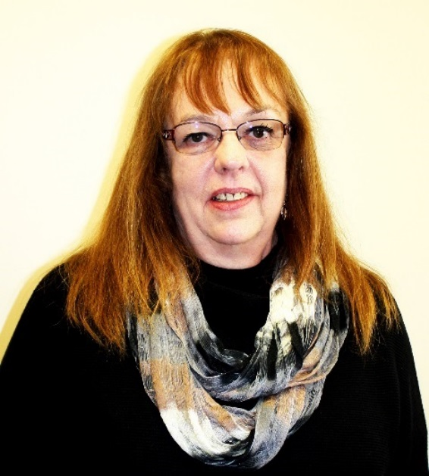
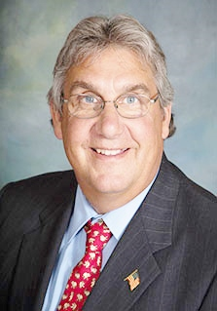
2016 Board of Directors
3rd Vice President Danny Hanning
Highway Commissioner Huntsville Township Schuyler County
Secretary
Susan Curtiss
Supervisor Esmen Township Livingston County
President Karen L. Reese
Assessor Newell Township Vermilion County
1st Vice President
Robert J. Miller
Highway Commissioner Algonquin Township McHenry County

Slide 4
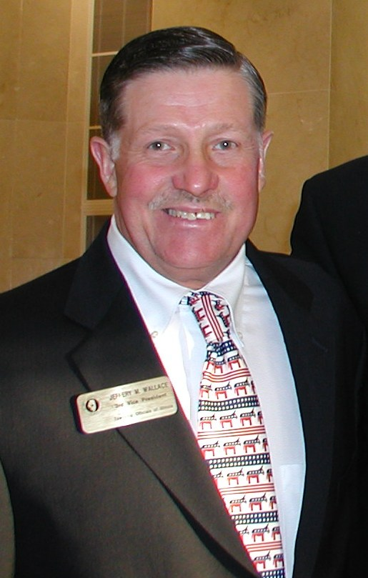
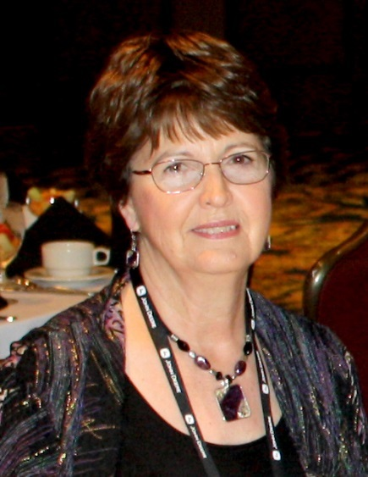
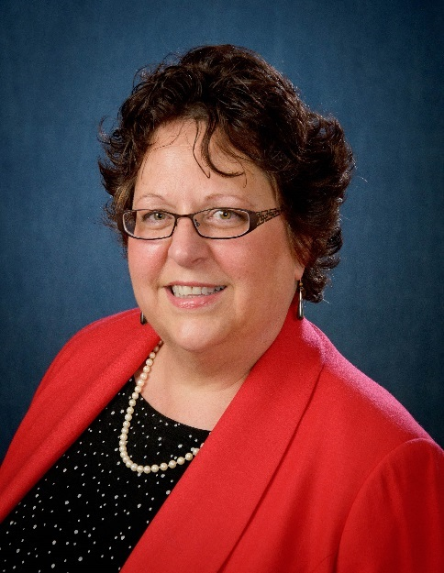
M. Carroll Carroll
Tax Collector Brimfield Township Peoria County
Immediate Past President Jeff Wallace
Trustee Joliet Township Will County
Treasurer Judy Herrman
Clerk Spring Lake Township Tazewell County
Katy Dolan Baumer
Clerk
Hanover Township
Cook County

Slide 5
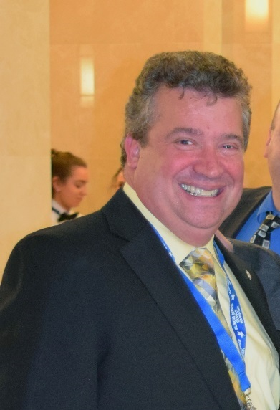
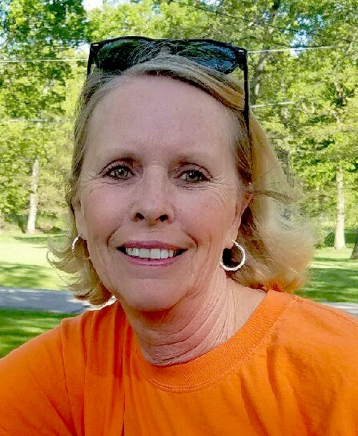
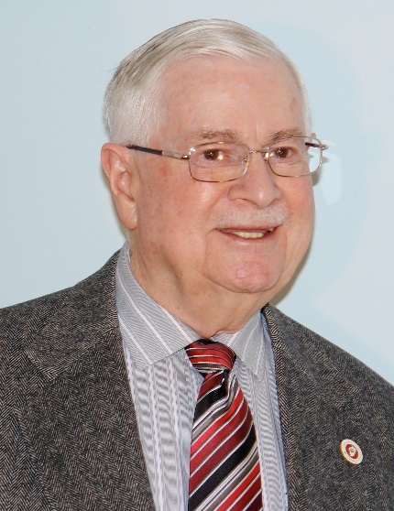
John Dabrowski
Assessor
Bloomingdale Township
DuPage County
Christine Filbert
Highway Commissioner
Cordova Township
Rock Island County
William Donnan
Clerk
Ela Township
Lake County
Mike Foley
Trustee Venice Township Madison County

Slide 6
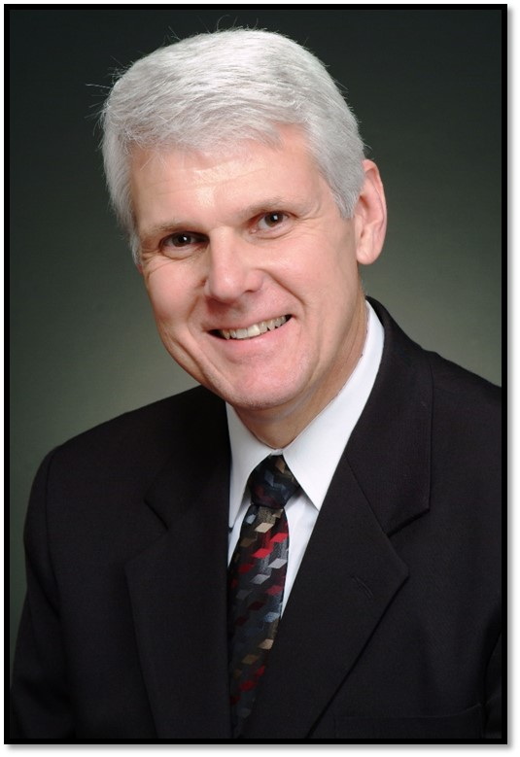
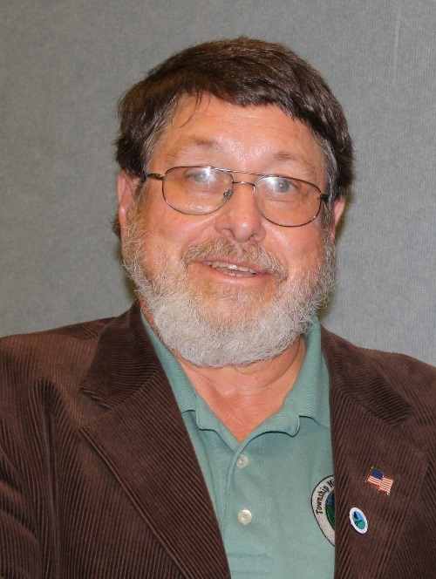
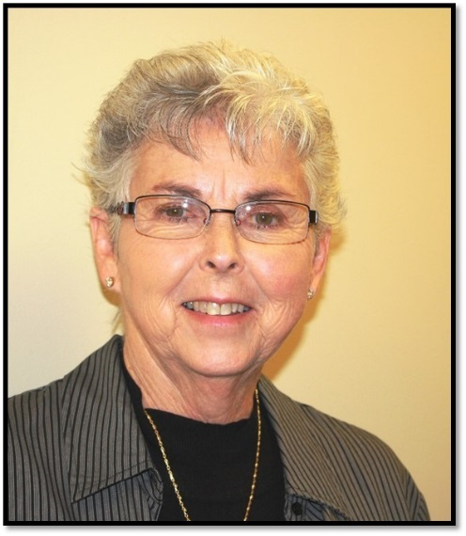
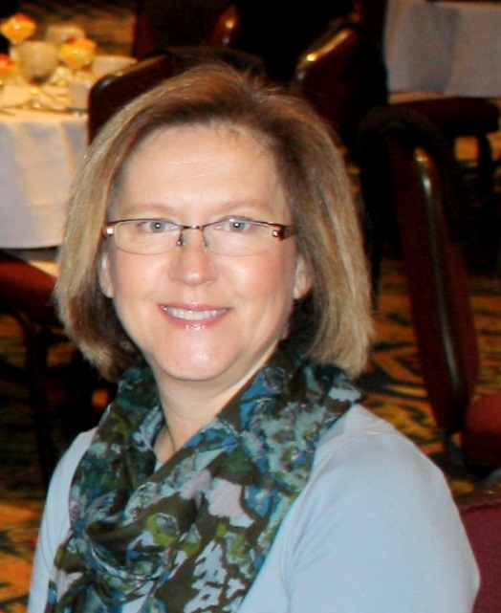
Leslie Hild
Highway Commissioner
Mt. Pulaski Township
Logan County
Mickey Goral
Supervisor Rockford Township Winnebago County
Mary Hamilton
Trustee
Aetna Township
Logan County
Lisa Hodge
Clerk
Blackberry Township
Kane County

Slide 7
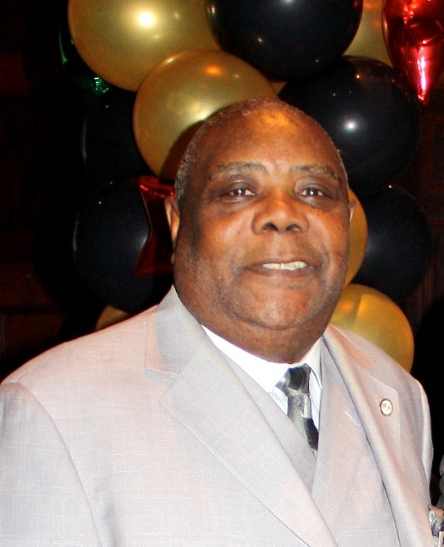
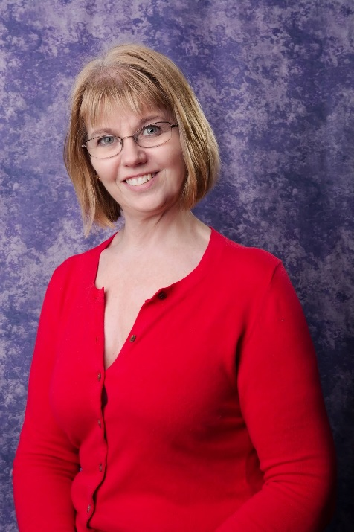
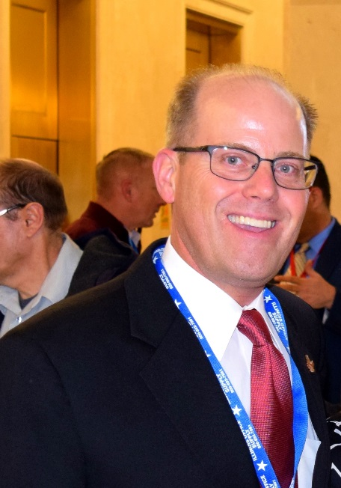
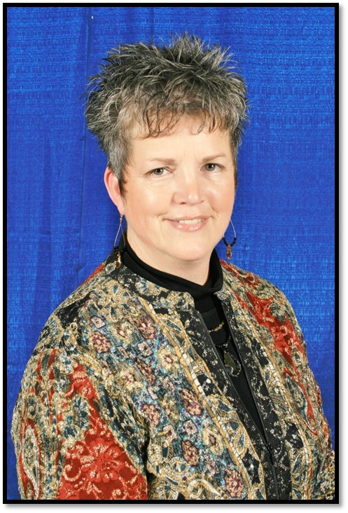
Percy Johnson
Trustee Waukegan Township Lake County
Sherrill Knorr
Supervisor
Reed Township
Will County
Christopher Kain
Assessor
Addison Township
DuPage County
Deb Lane
Multi-Township Assessor
Meriden/Ophir/Troy Grove Townships
LaSalle County

Slide 8
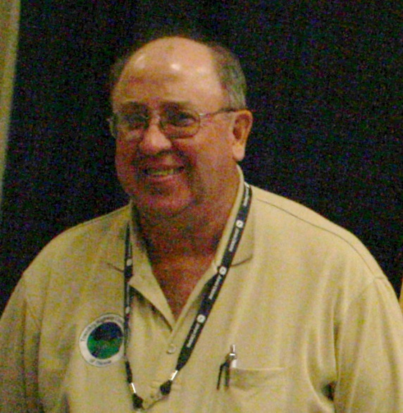
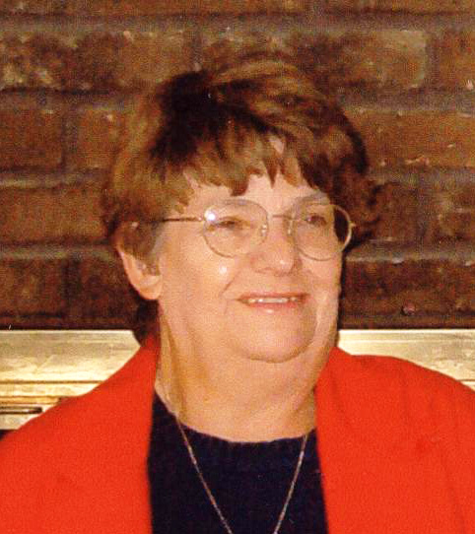
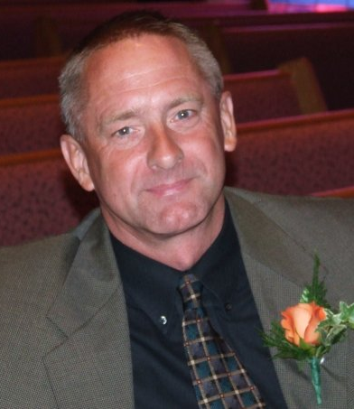
Darrell Maxheimer
Highway Commissioner
Rochester Township
Sangamon County
Karen Megan
Tax Collector
Millbrook Township
Peoria County
Sherry Meadows
Assessor
Mt. Vernon Township
Jefferson County
Charlie Montgomery
Highway Commissioner
Monticello Township
Piatt County

Slide 9
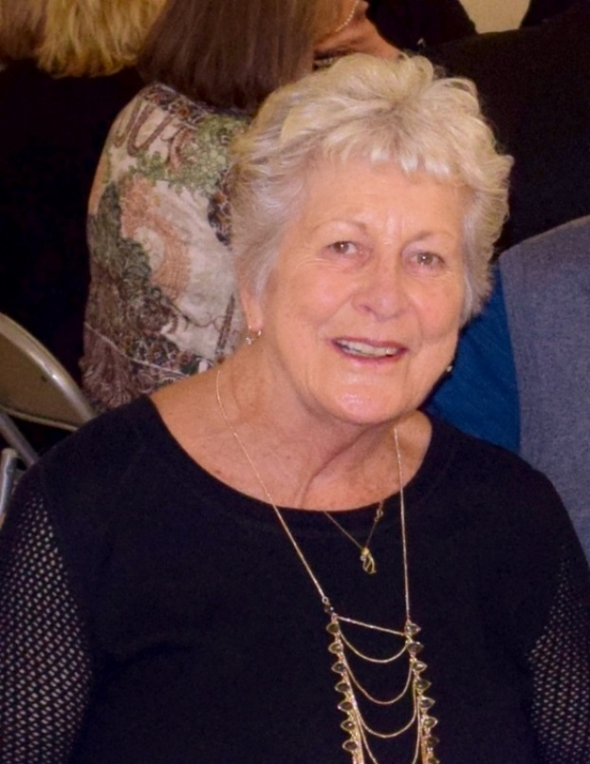
Craig Paulek
Clerk Stonington Township Christian County
Richard Phillips
Trustee
Normal Township
McLean County
Lucy Prouty
Supervisor Ela Township Lake County

Slide 10
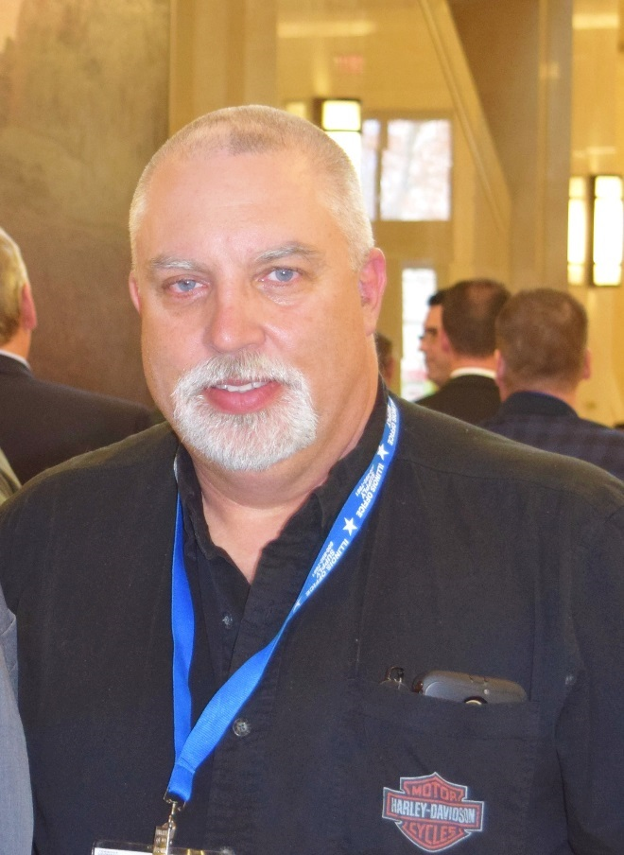
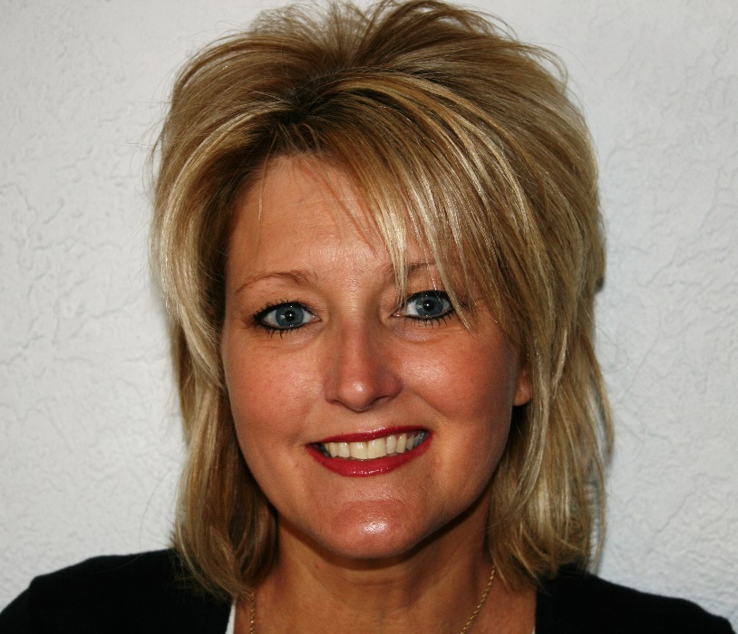
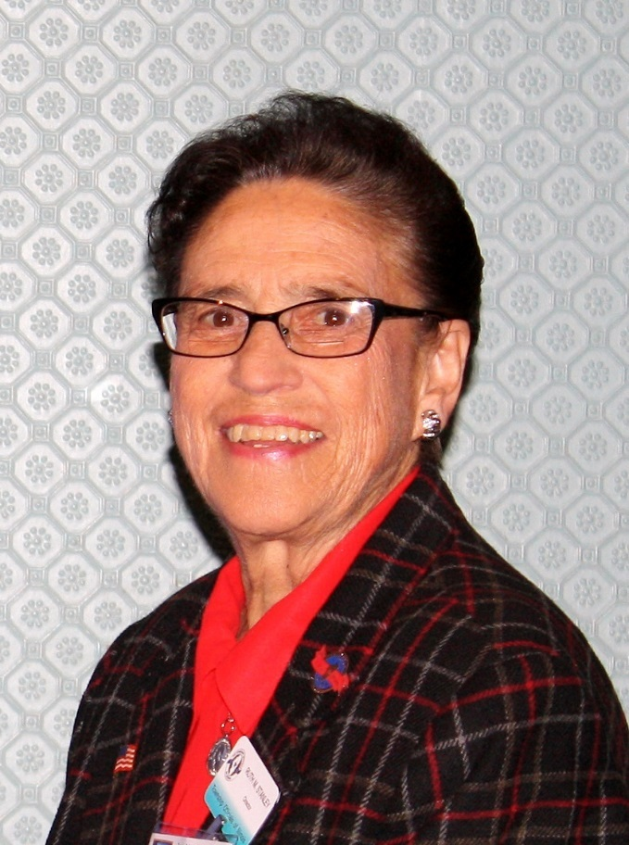
Sherry Tite
Clerk
Wood River Township
Madison County
Arnold Vegter
Highway Commissioner
Union Grove Township
Whiteside County
Ruth Stanley
Trustee
Sterling Township
Whiteside County

Slide 11
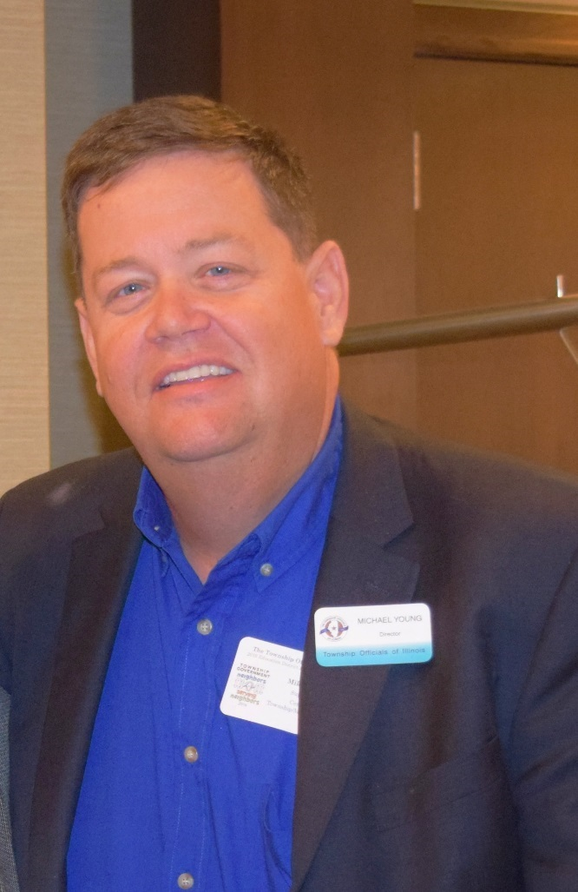
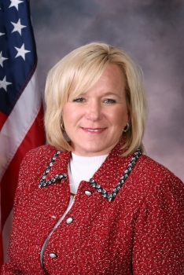
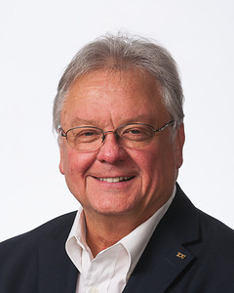
In Memoriam
1949 -2016
Patrick Murphy
Supervisor, Belvidere Township/Boone County
Member of the TOI Supervisors Division
TOI Board member since 2014
Deanna Wilkins
Assessor York Township DuPage County
Michael Young
Supervisor
Centralia Township
Marion County

Slide 12
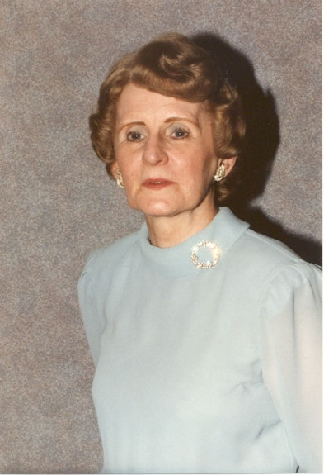
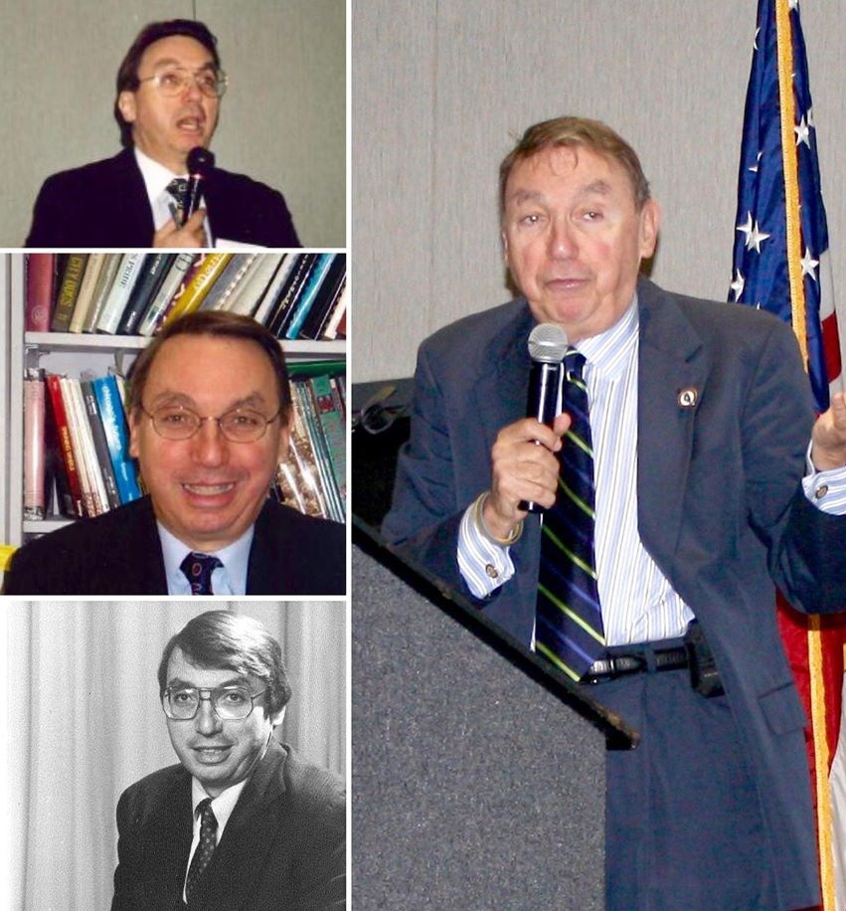
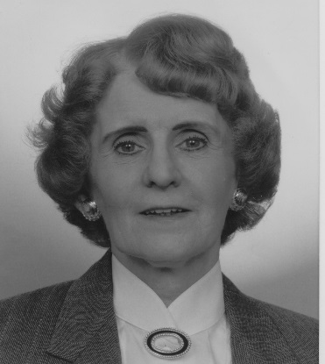
In Memoriam
Dr. Paul Green
1943-2016
Shirley J. Green
1925-2016
Dr. Paul Green was a familiar face at TOI education events in the 1980’s, 1990’s and early 2000’s.
Dr. Green led the charge by putting together training seminars for township officials co-sponsored by
the Illinois Department of Commerce and Community Affairs, Governor's State University's Institute for Public Policy and Administration, and TOI.
He also served as a township official, as Monee Township (Will County) Supervisor from 1977-1983.
Shirley J. Green was TOI’s first female president and a former assessor for Rich Township (Cook County) for 20 years.
Shirley became a member of the TOI Board of Directors in 1977. She served as Secretary of TOI Board 1980-1983, 3rd Vice President of TOI Board 1983-1985, 2nd Vice President of TOI Board 1985-1986, 1st Vice President of TOI Board 1986-1989, President (1989-1991). She also held the office of President of the Cook Township Assessors Organization, President of the Township Officials of Cook County, President of the Illinois Assessment Institute, and served on the TOIRMA Operating Committee. She received an award from the Illinois Township Assessor's Association as well as the Marshall Thoreau award for distinguished professional and personal dedication.

Slide 13
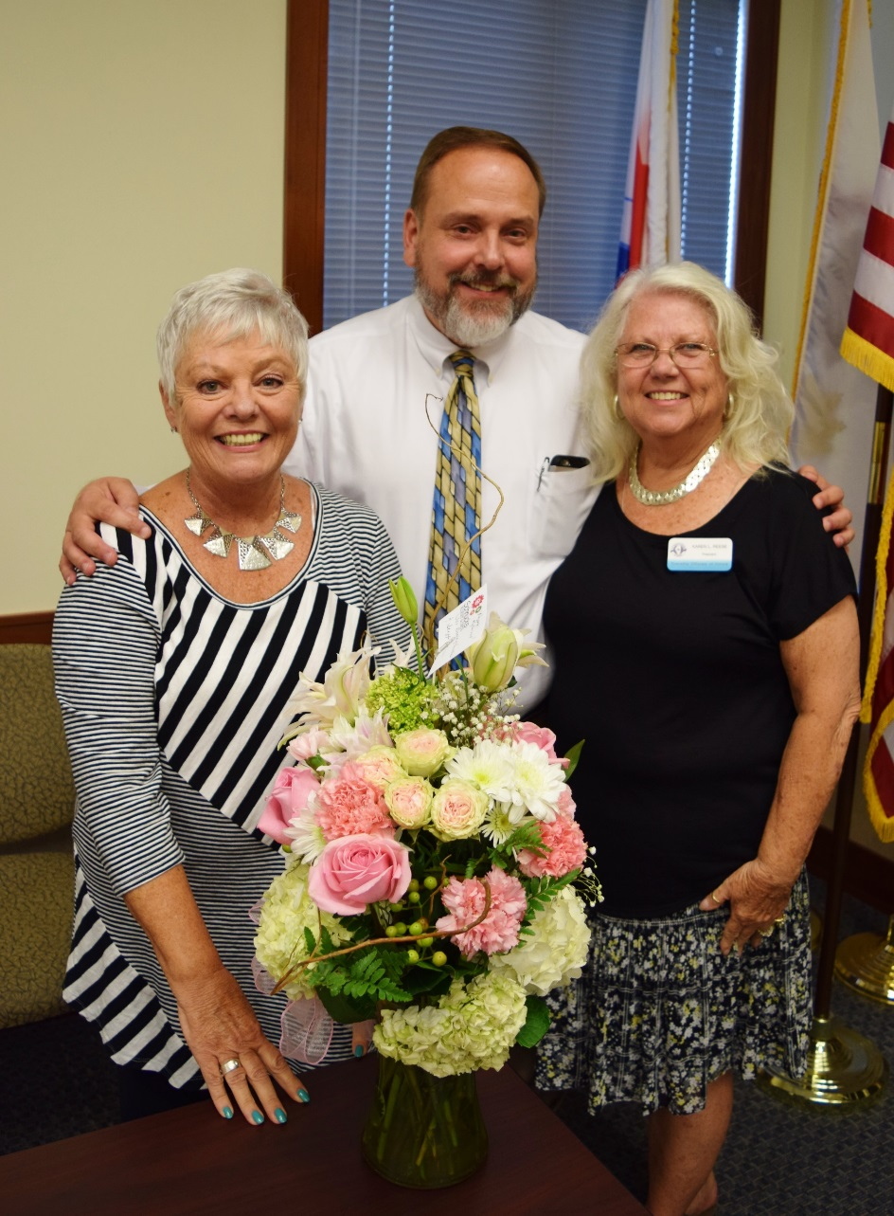
Congratulations to TOI 2nd Vice President/South Rock Island Assessor Susie Carpentier, who retired on August 31. She has been a township assessor since 1993.
Pictured from left to right: TOI 2nd Vice President/South Rock Island (Rock Island County) Assessor Susie Carpentier, TOI Executive Director Bryan Smith, and TOI President/Newell Township (Vermilion County) Assessor Karen Reese.

Slide 14
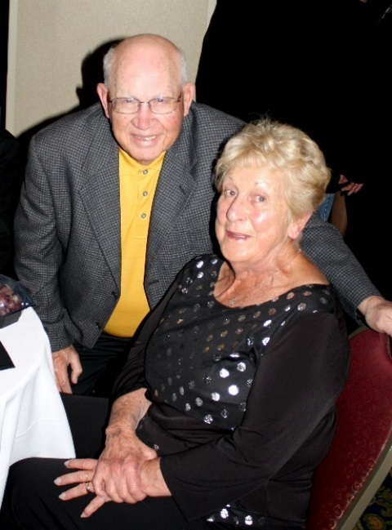
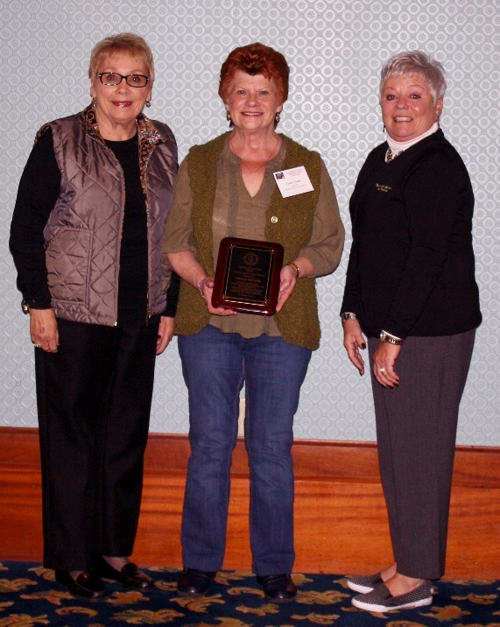
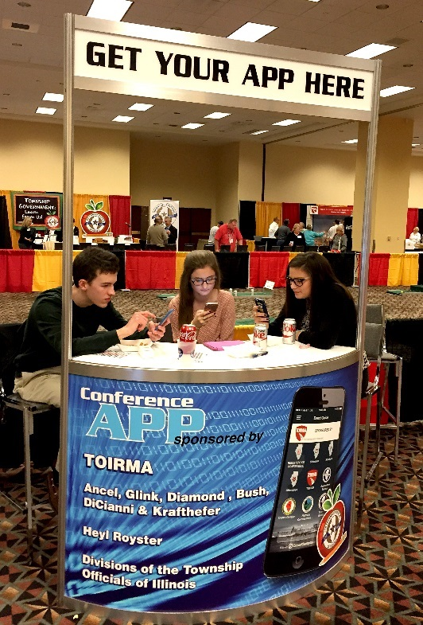
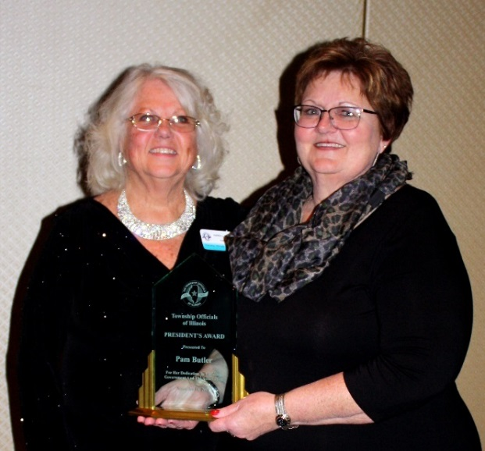
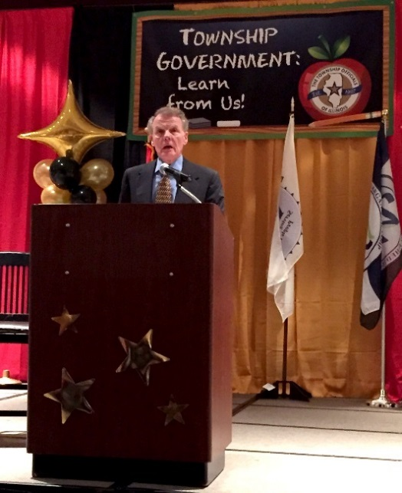
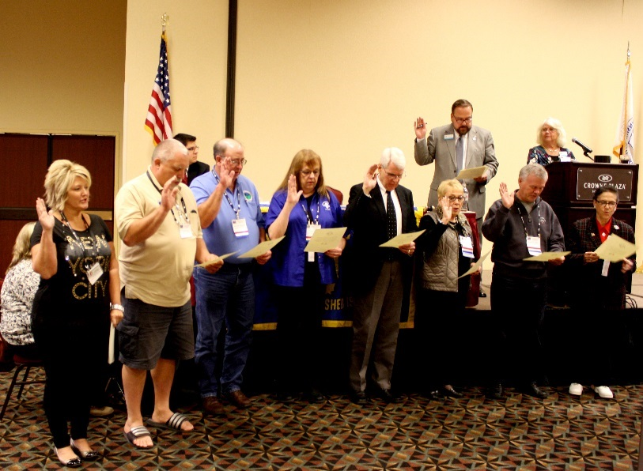
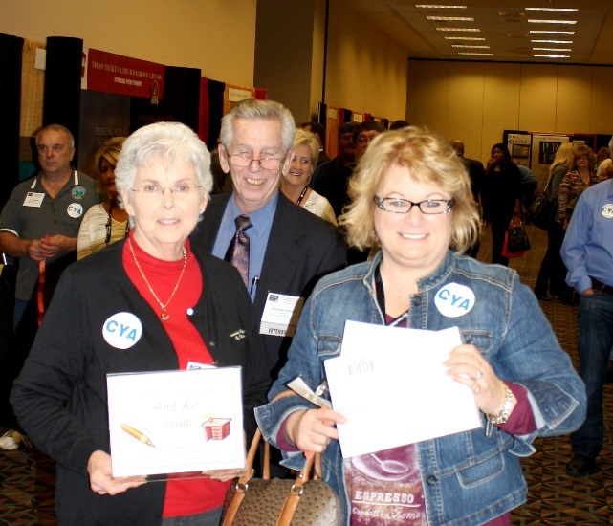
Scenes from the 2015 Conference

Slide 15
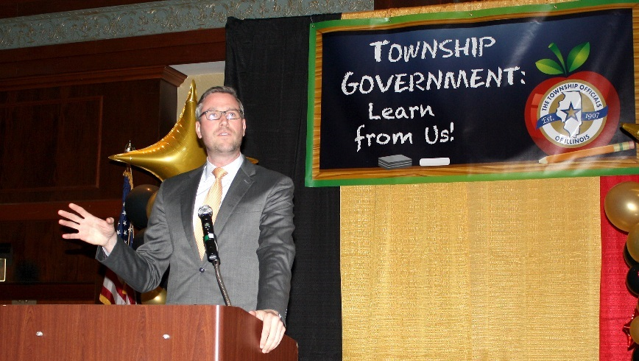
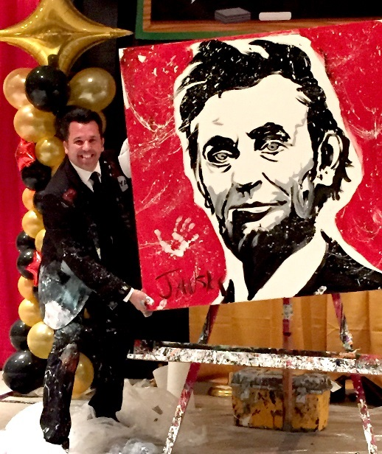
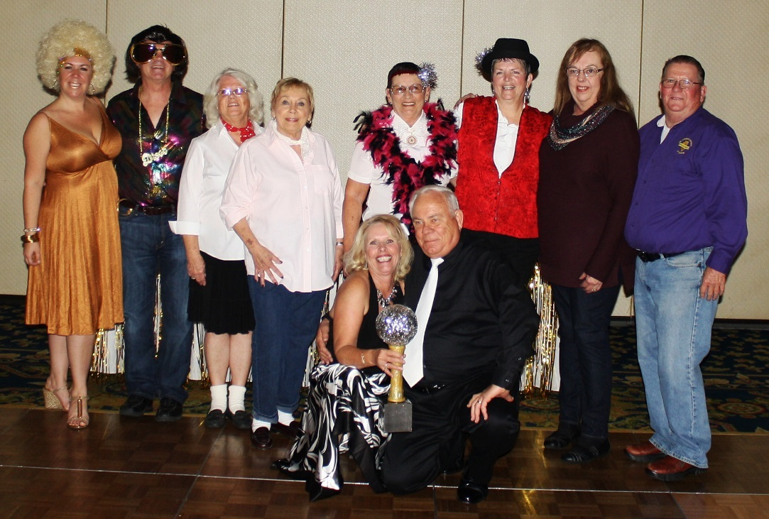
Scenes from the 2015 Conference

Slide 16
Scenes from the 2015 Conference

Slide 17
2016 Education Program

Slide 18
2016 District Education Program
Lisle/Naperville

Slide 19
Rockford

Slide 20
Collinsville

Slide 21
Normal

Slide 22
Professional Development 2016

Slide 23
Professional Development 2016

Slide 24
Professional Development 2016

Slide 25
34th Annual
Township Topics Day

Slide 26
Township Topics Day

Slide 27
Township Topics Day

Slide 28
Township Topics Day

Slide 29
NATaT Fly-In
Washington, DC

Slide 30
NATaT Fly-In
Washington, D.C

Slide 31
NATaT Fly-In
Washington, D.C

Slide 32
Annual Town Meeting
Douglas Township
Six Mile
Township

Slide 33
Annual Town Meeting
Maine
Township

Slide 34
From Around the State
Ela Township
Elsah Township

Slide 35
From Around the State
Frankfort Township
Freeport Township

Slide 36
From Around the State
Danville Township
Chillicothe Township

Slide 37
From Around the State
West Galena Township
Six Mile Township

Slide 38
From Around the State
Maine Township

Slide 39
From Around the State
Sandwich Township
Yates Township

Slide 40
From Around the State
Lockport Township
Long Creek Township

Slide 41
From Around the State
Rock Island Township

Slide 42
From Around the State
Hanover Township

Slide 43
From Around the State
Rosefield Township
Richwoods Township

Slide 44
Thank you to our 2016 conference sponsors and exhibitors!

Slide 45
2016 Conference Sponsors
Platinum Sponsors

Slide 46
2016 Conference Sponsors
Gold Sponsors

Slide 47
2016 Conference Sponsors
Township Officials of Illinois Divisions
Silver Sponsor
App Sponsors

Slide 48
2016 Exhibit Hall Participants
AITCOY - The Association of Illinois Township Committees on Youth
*Allied Benefit Systems, Inc.
Ameren Illinois
BioSpan Technologies
*Clarke
Ecolane
*Enbridge
*FORCE America, Inc.
Greenfield Contractors LLC
IDOT Technology Transfer Center
ITASCSC, Illinois Township Association of Senior Citizen Services Committees
Illinois Assessors Association
Illinois Municipal Retirement Fund
Illinois Township Trustees Association
Local Government Health Plan
Martin Equipment of Illinois, Inc.
Mid-West Truckers Association, Inc.
Phoenix Services LLC
*Stonehugger Cemetery Restoration
TIPS
*TOIRMA
Township Highway Commissioners of Illinois
Township Officials of Illinois
Township Officials of Illinois Clerks Division
*Visual PAMSPro
Waukegan Township
Wm. Nobbe Co.
*Woody's Municipal Supply Co.
*Associate Company Members

Slide 49
Reminders
Please download the TOI Conference App available for download through iTunes or the Google Play Store.
If you are having trouble downloading, updating, or navigating the conference app, stop by the Mobile App booth outside of the Exhibit Hall or the TOI booth inside the Exhibit Hall for help.
There is free Wi-Fi access for conference attendees at the Crowne Plaza:
Network: Crowne Plaza Conference
Password: thanks

Slide 50
Reminders
Don’t miss our special Monday night fun event! This year’s event will feature:
A DJ providing music from 8:00 to 9:00 p.m.
Dueling pianos performed by Fun Pianos! by 176 Keys from 9:00 to 11:00 p.m.
Bean bag tournament
Complimentary beer, wine and soda will be provided by our friends from TOIRMA.

Slide 51
Reminders
Be sure to attend your division meeting, Tuesday, 12:00-2:45 p.m.
See the program or app for additional details
Thank you for attending our 109th Annual Educational Conference!
We hope you have a great experience!

